Slide 1
Easing the Frustrations around Evaluating Transition Services Under WIOA
Kimberly Osmani
Transition Coordinator
Oklahoma Department of Rehabilitation Services (DRS)

Slide 2
Objectives for Today
Understanding requirements of WIOA for transition
Become knowledgeable of methods for documenting and evaluating provision of pre-employment transition services
Share ways for documenting and evaluating the provision of services to youth and students with disabilities

Slide 3
https://www.youtube.com/watch?v=FWnVNJCQZIg

Slide 4
Evaluate The Interview
Did candidate receive appropriate training on interview skills?
Was candidate completely inappropriate?
Did HR representative maintain control of the interview?
Was this an effective interview? For whom?
It’s all about perspective.

Slide 5
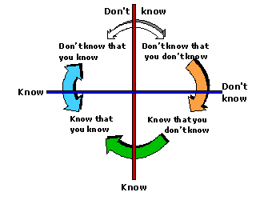
What we “DO” Know v. Unknown

Slide 6
Opportunities Provided through WIOA for Transition
Services to Groups
Youth or students 14-24; In or out of school
Reduces:
costs per individual
burden on families to apply unless intensive services are needed
administrative burden on counselors (access to kids, less time on paperwork, reach broader group)
Examples: Labor market info, self-advocacy and self-determination, how to do resumes, college tours

Slide 7
Documentation
What documentation will be required?
Will we have to capture student information?
Name, grade, date of birth, social security number, status of in/out of school, youth v. student
What else will we need to capture?
Sign-in sheets, evaluations, etc.

Slide 8
Impact on Vocational Rehabilitation (VR) Programs
WIOA and Changes
Potentially Eligible
Partnerships (local, state, regional)
Focus on Science, Technology, Engineering, and Math (STEM)
Customized Employment as a Service
Focus on Competitive Employment (compensation and benefits)
Student v. youth

Slide 9
Documentation
How will we document “potentially eligible?”
What will you look for in case documentation regarding information shared about STEM?
Will states need to capture jobs acquired in STEM fields or even work experiences/job shadows in STEM fields?
How will we document receipt of benefits as part of employment? How will that be reported?

Slide 10
Impact on Vocational Rehabilitation (VR) Programs
WIOA and Changes
Individualized Plan for Employment (IPE) may contain an employment “outcome” or “projected outcome” for youth or students; amendments are OK!
Pre-Employment Transition Services (PETS)
15% of agency’s federal award
Only to “students” but transition services can be provided to youth (just not counted in 15%)

Slide 11
Documentation
Amendments are OK.
Enough is enough of closures with generic goals.
Transition is an exploration and development process, and IPEs should reflect that.
15% of 110 funds for PETS activities—CFO and AWARE/LIBRE/ETC. data managers

Slide 12
Impact on Vocational Rehabilitation (VR) Programs
WIOA and Changes
PETS (5 required and other authorized)
5 Required Areas
Job exploration counseling
Work-based learning experiences such as Internships
Counseling on opportunities for postsecondary training
Job readiness skills training to develop social and independent living skills
Self-advocacy instruction

Slide 13
Potential Benchmarks
PETS (5 required areas)
Job exploration counseling
Time spent counseling job seekers (how many times do we expect them to actually “counsel” each?)
$ paid to counsel job seekers (should we see a minimum amount per job seeker?)
$ for materials, equipment, etc. for career counseling? Is it allowed?
Work-based learning experiences such as Internships
$ spent on wages to youth/students
Staff time developing experiences, meeting with employers
$ spent on Project SEARCH, WAT (is time important?)

Slide 14
Potential Benchmarks
PETS (5 required areas)
Counseling on opportunities for postsecondary training
Time spent counseling job seekers (how many times do we expect them to actually “counsel” each?)
$ paid to counsel job seekers (should we see a minimum amount per job seeker?)
$ for materials, equipment, etc. for career counseling? Is it allowed?
Staff time for college, CareerTech visits?

Slide 15
Potential Benchmarks
PETS (5 required areas)
Job readiness skills training to develop social and independent living skills AND Self-Advocacy Instruction
Staff time?
$ paid to provide instruction?
Minimum amount of $ or time per each student?
Summer programs, other out of school day activities, co-teaching in classes (how do we document and what will we measure?)
Partnership with ILCs; $ contracted to provide

Slide 16
Documentation
15% of the funds need to be spent on the 5 required areas first before being spent on the “other authorized”
What are states doing to capture that and NOT make it a documentation nightmare?
Time tracking?
No administrative costs, like travel, per diem, hotel
This is easy for states who open cases at 16 or earlier.

Slide 17
Impact on Vocational Rehabilitation (VR) Programs
WIOA and Changes
Focus on out-of-school youth (with most significant disabilities)
Subminimum wage (Section 511) (takes effect 7/22/2016)
No youth unless also accessing services through WIOA and/or IDEA; No Contracts
Exceptions
Goal is competitive integrated employment
Individual and/or their family must receive information and career counseling services every 6 months for the 1st year and annually thereafter as long as they are still receiving subminimum wage
Semi-Annual reviews for 1st 2 years; annually thereafter
Pretty easy to document, just need a process in place

Slide 18
Impact on Vocational Rehabilitation (VR) Programs
WIOA and Changes
Supported Employment (50% for youth)
CFO and data manager
Up to 24 months for all with most significant disabilities
Extended Services (4 years)
Changes in milestones or other payment structures
Regular reviews need to be documented in casework; how will decisions be made on closures and ensure closing at best time for job seeker

Slide 19
Performance Measurements
% who obtain a recognized postsecondary credential, or secondary school diploma or equivalent, during program or within 1 year after exit of program
Primary indicators for youth
% in education/training or unsubsidized employment during 2nd quarter after exit of program
% in education/training or unsubsidized employment during 4th quarter after exit of program
Primary indicators of performance in (III) through (VI) of subparagraph (A)(i)

Slide 20
Performance Measurements
Credentials
Participants who get a secondary diploma or equivalent shall be included in % counted as meeting criterion only if they have also obtained or retained employment or are in education/training program leading to a recognized postsecondary credential within 1 year after exit of program
State Adjusted Indicators (must have in state plan levels of performance established)
Youth program chapter 2 subtitle B
HUH?

Slide 21
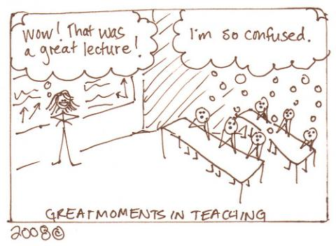

Slide 22
Contact Information
Kimberly Osmani
kosmani@okdrs.gov
(405) 635-2768
(405) 343-8071
5813 South Robinson Avenue
OKC, OK 73109

