Slide 1

WIOA & the VR ROI Project: Thoughts & Opportunities
9th Annual Summit on Performance Management in VR
Richmond, VA
September 8, 2016

Slide 2
Quick Survey
How many of you are familiar with ROI?
  Does your state agency calculate ROI?
  If so, how do they make this calculation?
How many of you are familiar with the 38th IRI on Return on Investment? (VRROI.ORG)

Slide 3
What is the VR- ROI Project?
Funded by NIDILRR
2010 FIP involved 4 state VR agencies: both VR agencies, MD, and OK
  Objective: develop and test a valid, rigorous model for assessing ROI at state agency level
2014 DRRP expanded to 8 state agencies across 6 states (VA, MD, OK, DE, KY, TX)
  Refine and test the ROI model with more heterogeneous set of state agencies
  Explore feasibility of a VR-ROI Calculator
Using data on 3 cohorts: SFY 2000, 2007, 2012

Slide 4
VR-ROI Project Team
Those who are at the Summit
Bob Schmidt (PI), University of Richmond
John Pepper, University of Virginia
Steven Stern, Stony Brook University
Joe Ashley (Co-PI), Virginia DARS
Rob Froehlich (Project Coordinator), GW University
Maureen McGuire-Kuletz, George Washington University
Kirsten Rowe, Virginia DARS
Others who could not make it
Chris Clapp, Florida State University
J Morrow, Morrow Consulting
KD Nyegaard, Career Index

Slide 5
Objectives for Today
Describe some principles underlying the VR-ROI project
Draw parallels with principles underlying WIOA
Illustrate some of these principles with our findings

Slide 6
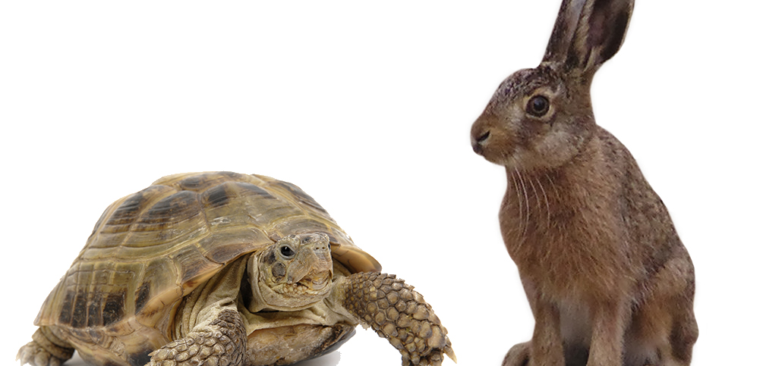
ROI and Celerity:
What is the “Formula”?

Slide 7
VR – ROI Project’s Approach
This is not your father’s VR ROI
  Nor is WIOA yesterday’s approach to reporting performance for workforce programs
As we envision it, VR ROI can provide
  A tool to learn about your program
  A supplement to the Common Measures. For example, for Virginia DARS applicants in 2000 who received VR services,
    80% enjoyed earnings gains that exceeded the cost of their VR.
    For every $1,000 spent by DARS, the median consumer earned $7,100 more over 10 years than they would have earned without VR services.
    The top 10% earned $45,100 (or more) over the same period.
Below we talk through and illustrate seven key features of our approach to ROI

Slide 8
VR – ROI Feature # 1:
Readily-Available Administrative Data
Uses readily-available administrative data from:
    State VR agencies (participant characteristics, services)
    State UI wage system (employment and earnings)
    FEDES, WRIS (if can obtain approvals)
  WIOA discussion of cross-agency administrative data
    Encourages use of common state identifier for individuals in core programs
      Would enable states to share data and track services across programs at the individual level
    Documenting competitive employment and earnings
      “unemployment insurance wage records, tax records, earnings statements from the employer, and self-reported information”
      RSA’s efforts on UI data

Slide 9
VR – ROI Feature # 2:
Estimate VR’s Impact from Service Start
Estimate VR’s impact from when services begin, not when they end (i.e., applicant cohorts rather than closure cohorts)
    Applicants in a given fiscal year face similar VR rules (including possible order-of-selection) as well as employment climate
WIOA and RSA
    RSA-911 report focuses on closures during a period
    However, RSA planning to review open cases quarterly for WIOA’s Measurable Skills Gains

Slide 10
VR – ROI Feature # 3 (slide 1 of 2):
Estimate Longitudinal VR Impacts
  Up to 3 years of pre-VR employment & earnings and at least 5 years of post-application data
    An increasing emphasis in VR on serving transitioning youth
    Placement-oriented services can have a quick impact; training and education likely to have longer-term impact
  WIOA has revised the metric for assessing a successful VR outcome
    Competitive Integrated Employment
    2nd and 4th quarters following closure
      Change from at the time of closure

Slide 11
VR – ROI Feature # 3 (slide 2 of 2):
Estimate Longitudinal VR Impacts
Earnings Impacts of 12-Day Assessment for Transitioning Youth (PERT, 1988)

Slide 12
VR – ROI Feature # 4:
Examine Impact of Specific Service Types
  Examine the impact of specific types of VR services
    DTERMPS: Diagnostic, Training, Education, Restoration, Maintenance, Placement, Job Supports
    For blindness services: Assistive Technology, Orientation & Mobility
  WIOA and RSA both acknowledge the richness of services provided by VR
    WIOA: “ensure that all individuals with disabilities served through the VR program are provided every opportunity to achieve” competitive integrated employment
    RSA: As of FFY 2014, RSA-911 closure file collects substantially more detail on more service categories (28 vs. 22)

Slide 13
VR – ROI Feature # 5:
Examine Impact for Different Disabling Conditions
  Examine the impact of VR for individuals with different kinds of disabling conditions
    Examples: mental illness, intellectual disability, learning disabilities, physical impairments, blindness and vision impairments
  WIOA and RSA
    RSA-911 has long collected information about disabling conditions
    Increasing emphasis on students and youths with disability

Slide 14
VR – ROI Features # 4 & 5:
Estimated Impacts by Service & Disabling Condition
Next three slides show employment and earnings impacts as estimated from our model
  One slide for each of 3 separate disability types,
  For 6 separate types of service (DTERMO)
  For the first 2 years following application (short run) and more than 2 years following application (long run)
Interpret the earnings impacts as being relative to a comparable individual who did not receive the service
  See Feature # 6 below

Slide 15
Service Effects on Labor Market Outcomes for People with Mental Illness
(DARS SFY 2000 Applicants)
Note: Vertical axis shows change in employment rate or proportionate change in earnings (if employed)

Slide 16
Service Effects on Labor Market Outcomes for People with Intellectual Disabilities
(DARS SFY 2000 Applicants)
Note: Vertical axis shows change in employment rate or proportionate change in earnings (if employed)

Slide 17
Service Effects on Labor Market Outcomes for People with Physical Impairments
(DARS SFY 2000 Applicants)
Note: Vertical axis shows change in employment rate or proportionate change in earnings (if employed)

Slide 18
VR – ROI Feature # 6:
Rigorous Statistical Model
Ideally, would observe same person with and without VR services over the same time period. But not possible.
To get closer to that ideal, the results above:
  Control for observed explanatory variables (e.g., gender, education, race, disability, local labor market conditions)
  Employ state-of-the-science statistical controls to ensure that the outcomes are the result of VR rather than other factors
How does the VR-ROI approach affect estimates of VR service effects?

Slide 19
Service Effects for People with Mental Illness
(DARS SFY 2000 Applicants):
Simple Comparisons vs. VR-ROI Model
Simple Model: Compares Svc Recipients to Non-Recipients
VR-ROI Model: Includes all 7 Features

Slide 20
VR – ROI Feature # 7:
Estimates Made at Individual Level
  The model estimates employment & earnings impacts at the individual level
    Provides flexibility in aggregating to obtain ROI estimates for different client groups
  Approach in alignment with WIOA’s intent to examine impact of VR services on earnings and outcomes
  Next three slides show ROI/ROR estimates for
    A collaborative transition program in Virginia
    Agency-wide ROI for Virginia DARS (SFY 2000 applicants)
    Three disability types among SFY 2000 applicants to Virginia DARS

Slide 21
VR – ROI Feature # 7:
ROI of a Collaborative Transition Program
PERT (Post-secondary Education/Rehabilitation Transition) Program
  Comprehensive career and independent living skills assessments at WWRC for high school students with disabilities who are selected by local school divisions
  Community-based team implementation of assessment findings
  Participants may receive additional VR services following PERT participation
Increases chances of finding and keeping a job by 12%
Combined with one more year of education the chance of getting and keeping a job increases by 38%
After you find a job, participating in PERT will on average double the amount of a student’s earnings in the long run
PERT Impact on Finding a Job and Income

Slide 22
VR – ROI Feature # 7:
Virginia DARS VR ROI “Elevator Speech”
For those VR applicants in 2000 who received VR services, 80% enjoyed earnings gains that exceeded the cost of their VR. For every $1,000 spent by DARS, the average (median) consumer earned $7,100 more over 10 years than they would have earned without VR services... And the top 10% earned $45,100 (or more) over the same period.

Slide 23
VR – ROI Feature # 7:
Annualized ROR by Disability Group
10-Year Rates of Return (Annualized) −
Virginia DARS, SFY 2000 Applicants
 | MI | MI (no Diag) | CI | PI
% with Negative ROR | 45% | 7% | 21% | 2%
ROR at Median | 3% | 40% | 35% | 141%
90th Percentile | 52% | 97% | 195% | 255%

Slide 24
Web Site: vrroi.org
Contact: Bob Schmidt
Professor of Economics
University of Richmond
rschmidt@Richmond.edu

