Slide 1
Making the Stretch:
Evaluating Business Needs and Informing Practices
8th Annual Summit
Performance Management in Vocational Rehabilitation
September 10, 2015
Liza Josias, ljosias@air.org
Ann Outlaw, aoutlaw@air.org
Cynthia Overton, Ph.D., coverton@air.org

Slide 2
Session Overview
Introductions
American Institutes for Research Background
Legislative Provisions
Gathering Data on Business Needs
Using Data to Work with Businesses
Measuring Outreach
Open Discussion

Slide 3
Introduction
Introductions
  Name
  Agency
  Role

Slide 4
American Institutes for Research Background

Slide 5
American Institutes for Research
Established in 1946
Independent not-for-profit organization that conducts behavioral and social science research and delivers technical assistance
Committed to providing solutions to challenges in education, health, and the workforce
Sample Clients
    Rehabilitation Services Administration
    National Institute on Disability, Independent Living, and Rehabilitation Research
    National Council on Disability

Slide 6
AIR Disability & Rehabilitation Work
1980s
Research, Dissemination, & Independent Living
2000s
Focus on Employment & Shift Toward Knowledge Translation (KT)
Today
Research, KT, Policy, Technical Assistance, & Training

Slide 7

Sample Project Overview
Effective strategies to improve employment outcomes for people with autism
Effective program identification

Slide 8
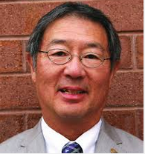
Familiar Face?

Slide 9
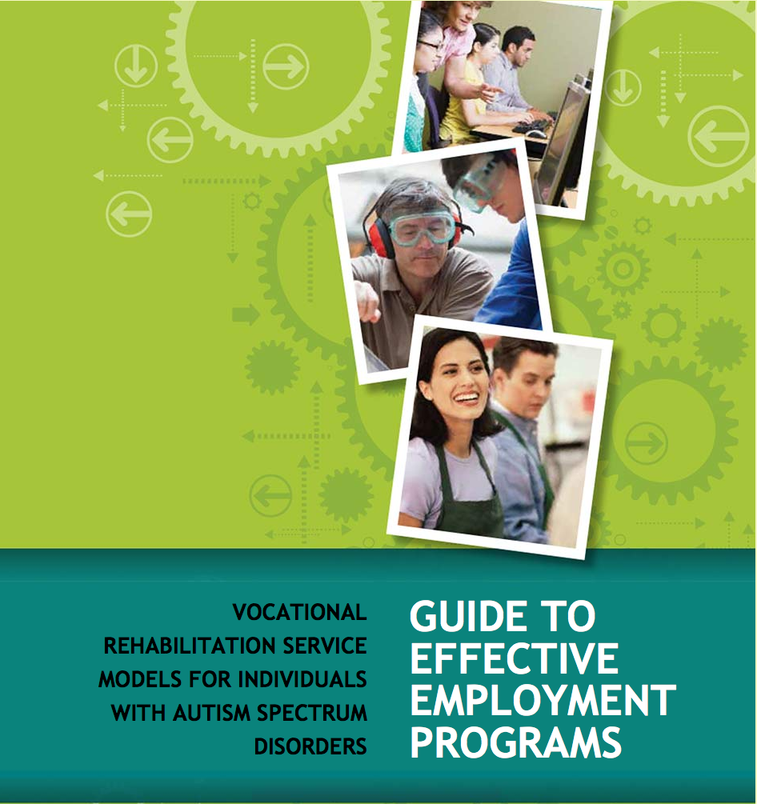
VR Autism Project
Critical Evaluation Factors:
Program Goals
Target Population
Recordkeeping
Success Rate
Cost
Evaluation Criteria
Staffing
Transportability
Innovation

Slide 10
Working with Businesses
Groden Network of Programs: The Cove Center
“Our job developers …will approach an employer honestly and with a clear objective (to help the person we're supporting to get a good job). They do this, however, with a "soft" approach. For example, they will ask the companies for a visit or a tour and to find out specifics about their operations and their needs.”
- Mike Smith
Director of Vocational Services

Slide 11

Understanding Business Needs
Photographic images on slide 12 supplied by iStockPhoto in compliance with SEDL's (an Affiliate of American Institutes for Research) annual license agreement

Slide 12
Legislative Provisions

Slide 13
Workforce Innovation & Opportunity Act
Guides VR professionals to:
  Identify and respond to needs of businesses
  Support businesses with recruitment, job matching, hiring, on-the-job training, accommodations, and retention
  Enhance engagement with in-demand industry sectors to increase competitive integrated opportunities

Slide 14
Section 503 of the Rehabilitation Act
More than 175,000 federal contractors
Several new provisions that impact federal contractors & subcontractors and creates a need to collaborate with VR
Opportunity exists for VR to apply lessons learned through outreach with contractors & subcontractors to other businesses

Slide 15
503 Motivation for Businesses
7% utilization goal for qualified individuals with disabilities
  Federal contractors with 100+ employees apply goal to each job group
  Federal contractors with fewer than 100 employees apply goal across the entire workforce

Slide 16
Additional New 503 Provisions
Data Collection
Invitation to Self-Identify
Equal Opportunity (EO) Clause
Records Access
ADAAA Definition of a Disability

Slide 17
Gathering Data on Business Needs

Slide 18
Connect with Businesses
VR agency designated business consultants
Chamber of Commerce
Organizations that have demonstrated a commitment to hiring people with disabilities:
  US Business Leadership Network (USBLN) members
  Top scorers on the Disability Equality Index
  Businesses listed at http://Disability.jobs/

Slide 19
A Human-Systems Integration Approach
Know Thy Businesses!
  Gather information to understand a business’s needs
Gather data on a business’s:
  Capabilities
  Limitations
  Perceptions
  Goals
Businesses
Job Candidates
VR Agency

Slide 20
What is a User Needs Analysis?
Gather information to understand the needs of users—businesses—to inform VR approach.
Benefits to VR Agencies & Businesses
  Provide businesses with relevant information
  Shared approach to creating solutions
  Tailor support to businesses

Slide 21
Conduct a Needs Analysis
Gather Information
  Conversations
  Observations
  Surveys
Review the Information
Identify Solutions for VR Support

Slide 22
Types of Data To Collect
Knowledge
Perceptions & Assumptions
Experiences
Capabilities
Limitations
Equipment & Technologies
Organizational Culture

Slide 23
Using Data to
Work with Businesses

Slide 24
Why Use Data?
Data gathered through a needs assessment can:
Identify the information needs of businesses
Identify misconceptions held by businesses
Guide VR agencies on how to allocate staff time, funding, and other resources

Slide 25
Barriers to Using Data
Technical jargon
Excessive information
Too much text
Vague, irrelevant, or otherwise unhelpful information

Slide 26
Making Data Useful
Specific recommendations tied to each finding
Visuals such as pull-out boxes with bulleted lists, tables, graphs
Infographics
Information represented using visuals should also be available in text so they can be accessed by screen-readers
Notes:
http://butleranalytics.com/10-free-dashboard-software/

Slide 27
Measuring Outreach

Slide 28

Using Data: Measuring Outreach

Slide 29
Measurement Framework
Performance Measurement
  Consumer Outcomes with context
  Education Outcomes
Continuous Improvement Metrics
  Criteria
  Quality Indicators
  From Alliance for Quality Career Pathways

Slide 30
Effective Program Evaluation Criteria
Job retention rate
Job hires
Annual satisfaction surveys to employees, businesses, and employees’ families
Monthly phone calls to employees and employers to check in about how things are going
Quarterly face-to-face employer feedback meetings with employees and businesses
New employment partners
Triumph Services, Inc.

Slide 31
Open Discussion
How does your agency typically gather insight on business needs?
How has your agency used data to respond to these needs?
How have you measured effectiveness and outreach?
How have you worked with the business consultant with your agency to gather data on business partners?

Slide 32
Contact Us
Liza Josias | ljosias@air.org
Ann Outlaw | aoutlaw@air.org
Cynthia Overton | coverton@air.org

