Slide 2
What is ExploreVR?
www.explorevr.org is a public web application that provides accessible Vocational Rehabilitation (VR) and related data
Our goal is to offer a compendium for researchers, practitioners, and policymakers and create a base of knowledge that provides a foundation for future research and evaluation efforts.
ExploreVR is being used as a knowledge translation (KT) tool and currently houses findings from four centers

Slide 4
Research Projects on ExploreVR
Vocational Rehabilitation Research and Training Center (VR-RRTC)
Vocational Rehabilitation RRTC on Demand Side Strategies
Substantial Gainful Activity Project (SGA)
Rehabilitation Training Center on VR Program Management (RTAC)

Slide 6
Knowledge Translation
Infrastructure supports collaboration, technical assistance and knowledge transfer
Research unit, Sr. Policy unit, KT unit
ExploreVR is one tool to facilitate access to research and data

Slide 8
About Our Work
ExploreVR features work focusing on:
VR program management practices that improve employment outcomes for people with disabilities
improve employment outcomes for individuals with disabilities receiving Social Security Disability Insurance (SSDI) benefits
produces knowledge regarding state VR agencies’ capacity for assessing and meeting business needs

Slide 10
Training & Technical Assistance
Webinars
Learning Collaborative
Communities of Practice
Request Technical Assistance

Slide 11
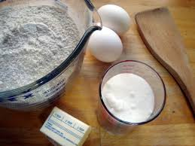
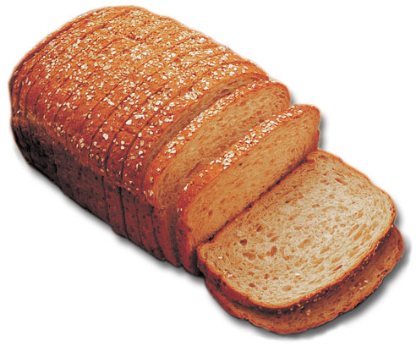
OR

Slide 12
Features of ExploreVR
Interactive Data Analysis
These pre-made analysis serve as a starting point to introduce the user to the capacity of Explore VR. These analysis can be manipulated by the user to meet data needs.
Explore It Yourself
All data used in Explore VR is publicly available for download in .xls and .csv format. Datasets will be accompanied by a data guide to improve ease of use.
Data Requests
All users may submit data analysis requests through Explore VR. Research staff at ICI will use Explore VR to answer your questions.
Monthly Featured Reports
Each month, Explore VR will release a featured report using its data.

Slide 13
Multimedia Products
Interactive toolkits focused on VR program management
Video series of SSDI clients
… and much more!

Slide 14
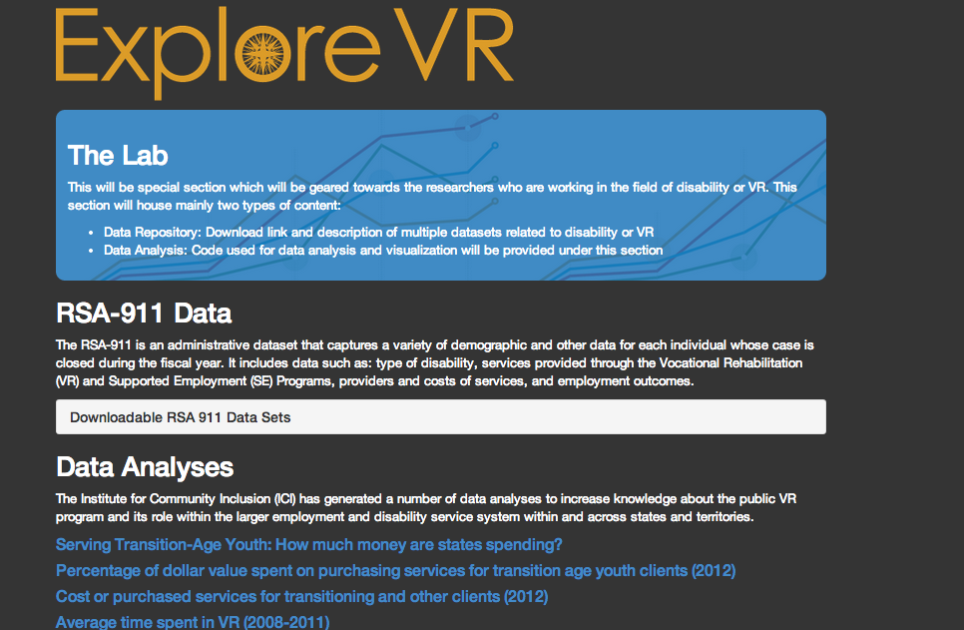
Data Lab

Slide 15
The Open Data Initiative
Explore-VR is committed to the "open data" initiative that is being embraced by the U.S. government and around the nation.
allow decision-makers, researchers and and web builders access to all of the VR data that we collect
release the data in its most raw form, as well as build useful applications to view the data
encourage others will build and expand off of the work that we put forth
For more information: www.whitehouse.gov/open

Slide 16
Policy & Practice Implications
ExploreVR is seeking to find the best mechanism to feed data back into policy and practice decisions that enable the federal-state VR system and ultimately public employment systems to effectively and efficiently deliver employment services.

Slide 17
Challenges we need to address
Improving accessibility
It needs to work on almost every device
Figuring out how to collaborate with other researchers, VR agency personnel, and the VR community as a whole

