Slide 1
Using On-Line Survey Tools in the Performance of QA Reviews
John Stem
7th Annual Summit on VR PEQA
Louisville, Kentucky
Notes:
During this presentation, I will briefly touch on how Maryland DORS previously conducted case reviews, and why we decided we needed a different process. The majority of this presentation will then be on the efficiencies discovered when building and using on-line survey software to conduct case reviews and report findings.

Slide 2
Background
DORS uses a 2-pronged case review system:
  Unit Case Reviews
    Review team composition
    Various views on policy and how to respond to specific questions were suspected to be compromising inter-rater reliability between reviews.
    “Technical difficulties”
  Delegated Authority Reviews
    Not truly “random”
    Need to be “perfect”
    No formal way to document which counselors needed to be reviewed each month.
    Inefficient process for submitting, processing, and summarizing reports.
Notes:
For over a decade, DORS used a database for collecting and storing responses to questions asked during formal unit case reviews conducted over a two-day timeframe. Each unit was reviewed once every two years, and forty cases were reviewed at a time.
In DORS, when a caseload-carrying counselor is promoted to “vocational rehabilitation technical specialist,” he or she may—at the discretion of the supervisor--have authority delegated to them to initiate plans costing the agency up to a maximum of $5,000, and to issue authorizations up to a maximum of $5,000, without receiving prior supervisory approval.
State auditors proved somewhat reluctant to endorse the continued use of delegated authority, and, in order to maintain this process, it became necessary for DORS to establish a formal means whereby supervisors would conduct random reviews of case work for counselors with delegated authority. To that end, a separate database was created to store responses to those reviews.
Both of these databases and the reports generated from them were designed and maintained by the agency’s MIS (Management Information Services) staff. Once the questions and reports were finalized, it was very difficult to make even the most minor of changes in the review instruments. For instance, INITIALLY technical specialists were allowed to determine a consumer’s eligibility and disability priority without prior supervisory review. Therefore, when conducting a delegated authority review, supervisors would respond to questions regarding whether the eligibility and OOS determinations were appropriate. Later, when it became necessary for supervisors to review and approve ALL eligibility and OOS determinations, the database still required that those questions be addressed.
Numerous concerns regarding these instruments persisted over the years, resulting in staff questioning the value of the case review process and resenting and, at times, circumventing the delegated authority review process.
Primary unit case review concerns:
The review team was different for each review. The team, led by 1 of 2 HQ staff, consisted of the Regional Director and a supervisor and a technical specialist from outside the region. The agency viewed these unit reviews as an opportunity for emerging leaders to see how case work was performed in other parts of the agency. Interestingly, it was often observed that the counselor seems to be the most critical of all the reviewers on the team.
The number of cases to be reviewed was divided equally between the reviewers. If reviewers were unsure about how to respond to a particular question, they could ask the HQ staff member leading the team, ask the regional director for a more local perspective, or consult the unit review manual. If they felt confident in their response to a question, they would enter their response and move on. Review teams typically were reviewing 40 cases in a two-day period. It was observed that discussion tended to decrease toward the end of the second day, as fatigue set in.
The HQ staff member leading the team was assigned a “database laptop.” All other laptops needed to be networked through a “hub” to that database laptop. Frequently, the team would sit idly for possibly a couple hours on the first day waiting for technical concerns regarding connectivity to be addressed before they could commence.
Primary delegated authority review concerns:
The reviews were supposed to be “random” and were supposed to occur PRIOR to the plan being initiated or the authorization issued. We use AWARE, and it is possible (though somewhat tedious) to identify a draft plan or authorization, but it is not so easy to know when the counselor is finished drafting that plan or authorization and ready to issue it. In practice, supervisors would either 1) ask the counselor to turn over to them for review a plan or authorization that they would otherwise initiate themselves, or 2) wait to review a plan or authorization that the counselor had to turn over to them for review due to other policy restrictions (such as the plan included services requiring administrative approval, or the authorization exceeded a specific $$ threshold.) Either way, these reviews were not random.
Supervisors had the impression that these delegated authority reviews were a reflection on them, and so would return cases to the counselor for correction prior to completing the reviews, so that they could honestly say that the case was 100% perfect by the time they submitted the review. This practice masked training needs that HQ hoped to identify via this delegated authority review process.
Frequently, there were legitimate reasons for supervisor NOT to conduct delegated authority reviews. For instance, an individual counselor may have been on FMLA or the supervisor may have removed delegated authority for issuing authorizations from all counselors for the last month of the FY, or, perhaps, a district had NO counselors eligible for delegated authority. However, when auditors came in to check on whether delegated authority reviews were being completed, they did not know all these reasons existed, and HQ needed to scramble to come up with answers as to why certain districts appeared to have so few reviews completed in a given month.
The “Ongoing Supervisor Record Review Instrument for Delegated Authority” was a standard DORS form available in the electronic forms manual on the DORS intranet. This was a fillable form that could be completed electronically and emailed, or printed, completed by hand, and faxed. Supervisors used various approaches when completing and then sending in their reviews to HQ. Some supervisors would funnel their reviews through the Regional Office, creating a bottle neck, either because the regional office wanted a way to track whether they were being completed or because the supervisor wanted to be sure the regional office knew the reviews were being done. Ultimately, it was the job of the QA staff specialist in HQ to enter by hand the responses into the database, try to determine whether he had all the responses he would receive for that month, and then run monthly summary reports. So, you can imagine his frustration when he would receive in the mail reviews completed with dates from several months ago.

Slide 3
QA Tool Development Timeline:
May 2013: Quality Assurance Core Development Team begins a 12-month journey guided by consultants from the George Washington University TACE.
Summer 2013: Initial Activities
  Identify concerns about current case review process
  In the context of Quality Assurance:
    Define purpose of the Unit Review
    Define purpose of the Delegated Authority Review
  Review the sampling of case review instruments used in other states collected via the Summit list-serve.
  Compile a list of potential questions upon review of each chapter in the DORS policy and procedures manual
Notes:
In May 2013, the DORS Quality Assurance Core Development Team commenced what became a 13-month collaboration with consultants through the George Washington University TACE to refine the DORS case review system. DORS staff on the team consisted of regional directors from each region in the state and staff specialists. The consultants were Patricia Tomlinson and Tom Jennings, each former New Jersey VR state directors.
Our team commission included:
Formalizing the procedures used by district supervisors to conduct and document monthly case reviews of counselors with delegated authority.
Improving the Quality Assurance Case Review Instrument.
Describe Initial Activities . . .
Within the context of these activities, several ideas emerged which ultimately contributed significantly to the design of the case review instruments . . .

Slide 4
Key Objectives:
The DORS Quality Assurance system shall be designed to fulfill 5 purposes:
Evaluate measurable and achievable standards that are accepted as quality indicators of excellence in rehabilitation practice to ensure service delivery reflects these quality standards.
Monitor policy compliance and ensure statewide consistency with statutory requirements of federal regulation and state policy.
Ensure consumers receive information necessary to make an informed choice regarding an employment goal and services required to reach their goal, consistent with their strengths, resources, priorities, concerns, abilities, and interests.
Identify statewide, regional, district, and individual training needs and policy issues.
Identify exemplary rehabilitation practices and outcomes.
Notes:
The DORS Quality Assurance system shall be designed to fulfil 5 purposes:
(Click to reveal each purpose)
Evaluate measurable and achievable standards that are accepted as quality indicators of excellence in rehabilitation practice to ensure service delivery reflects these quality standards.
Monitor policy compliance and ensure statewide consistency with statutory requirements of federal regulation and state policy.
Ensure consumers receive information necessary to make an informed choice regarding an employment goal and services required to reach their goal, consistent with their strengths, resources, priorities, concerns, abilities, and interests.
Identify statewide, regional, district, and individual training needs and policy issues.
Identify exemplary rehabilitation practices and outcomes.

Slide 5
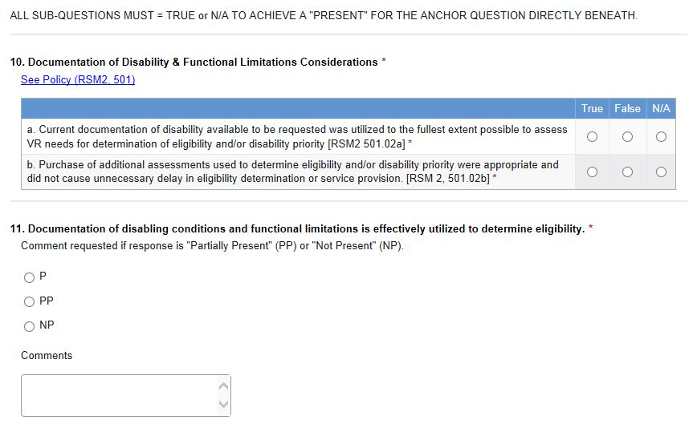
Key Concepts:
  Regarding Unit Case Review:
    Reflects the supervisor
    Inter-rater reliability must be assured
    Instrument needs to measure compliance and quality.
    Instrument needs to be flexible enough to respond to changes in policy.
Notes:
Regarding the Unit Case Reviews:
These reviews reflect the supervisor—we are looking for trends across cases-regardless of the counselor--to pick up on where the supervisor needs additional instruction or to provide additional oversight.
It is imperative that we assure inter-rater reliability via every possible means (links to policy, built in instruction, each case reviewed by two reviewers, consensus building)
More straightforward questions asked by auditors (e.g. was eligibility presumption timely, did the consumer sign the plan, etc.) are considered compliance questions. More multi-faceted questions—those with several, enumerated considerations, are considered measures of quality. Whether measuring compliance or quality, the questions are framed so that the reviewer may respond “Present,” “Partially Present,” “Not Present,” or, in rare instances, “Not Applicable.” For quality measures, however, “True” or “False” must first be answered for each enumerated consideration. If all applicable considerations are “True,” then the response to the anchor question summarizing them should be “Present.”
We need to be able to evaluate whether the instrument is giving us the information we need, and drop, add, or edit questions accordingly. For instance, at the end of each review cycle, before beginning the next one.

Slide 6

Key Concepts:
  Regarding Supervisory Delegated Authority Review:
    Reflects the counselor
    Could not practically be both “random” and “prior.”
    Accuracy of responses needs to be assessed
    Questions should be a relevant sampling of the questions found in the more comprehensive record review instrument used during unit reviews.
    A more efficient means of cataloguing responses would expedite summary reports.
Notes:
Regarding Supervisory Delegated Authority Reviews:
Because the review reflects the counselor, mistakes are to be expected, and the supervisor can be “honest.” This review is a mechanism for the supervisor to provide the counselor immediate feedback. (After each review is completed, SurveyGizmo will immediately email a copy of the review to the supervisor and the regional director, and the supervisor may forward the review to the counselor—and is expected to do so when issues are identified.)
We quickly determined that supervisors cannot randomly review a plan or authorization before it is issued, and that supervisors should not be picking which cases to review (because they could be cherry-picking) and should not be asking counselors to turn over cases for review (because they could be cherry-picking). Rather, regional directors should be randomly selecting plans and authorizations for each counselor who used their delegated authority in the previous month, and advising supervisors to complete their reviews. This served a secondary but equally important purpose of documenting how many reviews are requested each month and why reviews were not requested for a specific counselor in a specific month.
It is not enough for a supervisor to do the prescribed number of delegated authority reviews, but the accuracy of their responses need to also be examined. Having supervisors respond to the same questions while conducting delegated authority review as unit reviewers are responding to during unit reviews will help us assess whether there is congruence.
By requiring supervisors to use only one method to perform case reviews—and preferably a method that does not require data entry by hand into a database—we will be able to count on much more efficient reports.
These concepts all crystallized in the formation of a goal to build our new Quality Assurance Case Review System using an on-line survey instrument as its foundation.

Slide 7
Delegated Authority Review Change Timeline:
October 2013:
  Replicate the current “On-Going Supervisor Record Review Instrument” using an on-line survey tool
  Build new AWARE case search and financial search layouts and a new survey tool for Regional Directors to use when selecting plans and authorizations to review and sending review requests to supervisors.
  Build Matrix reports to use for monthly and quarterly reporting on reviews completed.
November 2013: Train regional directors and supervisors on new delegated authority review instrument protocols.
January 2014: Implement new delegated authority review procedures beginning with reviews of plans and authorizations initiated in December 2013.
Notes:
Not knowing how long it would take us to complete the revisions to the QA Unit Review Instrument, we chose to first introduce supervisors to the new process of completing delegated authority reviews via the on-line system. This allowed them to become familiar with accessing the tool via a link on their desktops, and using the new instrument to answer questions with which they were familiar.
In March 2014, SurveyGizmo experienced a Denial of Service Attack during which none of their customer’s surveys could be used for almost a full week. In response, we left the window for completing reviews requested for that month open for the same number of days into April so that supervisors would have a fair opportunity to complete the reviews requested of them. However, since we don’t have the luxury to complete unit reviews several days later than scheduled, this was a reminder for us that we needed to have a “Plan B” ready in case future events cause the on-line survey instrument to be unavailable.
Since January 2014, OFS and OBVS supervisors have completed over 1,200 reviews of plans or authorizations using this new system.
Regional Director and Supervisor feedback has been quite favorable—supervisors especially like that they don’t have to interrupt their counselor’s case flow by recognizing a prime opportunity to complete a review. They now know how many reviews need to be done and can set aside time on their calendars to complete their reviews before the end of the month.

Slide 8
QA Unit Review Change Timeline:
December 2013: Compile first draft of new QA Review Instrument in an Excel document.
January 2014: Select three cases for the entire QA Core Development Team to review using the new instrument, and “questioning the questions” ensues.
February 2014: Next draft; next trial run
March 2014: Next draft, next trial run
April 2014: Finalize draft for review by Executive Staff and State Rehabilitation Council
May 2014: Introduce new record review instrument to supervisors and address questions.
June 2014: Pilot use of instrument using SurveyGizmo with 8-person, core team and 12 cases for one district review
July 2014: Begin monthly review cycle--one case per caseload; two reviewers per case.
Notes:
During the February and March 2014 trial runs, we drew two conclusions which ended up dramatically affecting how many cases we could plan to review during any given two day period of time: 1) Regional directors would not be on the review team, but rather would be available for questions, if needed, and would participate in a meeting to debrief with the district staff whose cases were reviewed at the end of the unit review, and 2) to assure inter-rater reliability, each case would be reviewed by two reviewers, their answers compared, and then consensus built before the summary report was published.
The decision to scale out the Regional Directors, left us with 6 core review team members. So, we determine we needed to add two more staff, who had formerly worked as caseload carrying counselors, to the team.
Adding these two additional staff prior to the pilot turned out to be excellent timing, because they were able to use the instrument without having been involved in any of the core development activities.
During the June 2014 pilot, our 8-person team reviewed two cases per caseload in one district. We reviewed 12 cases, and each case was reviewed by two people, equaling 24 separate reviews or 3 cases per person. Prior to consensus building we were 75% congruent in our responses, leaving 25% of the responses which needed to be reconciled before we were ready to report our findings.
Since we knew that we would be moving forward with teams of 4 or occasionally 5 persons per monthly review, we determined that we would review 1 case per caseload (keeping in mind that these are district reviews, rather than counselor reviews, and a maximum of 10 cases per review. With each case reviewed twice, that is 20 reviews, or 5 reviews per reviewer. This also allows us to complete several smaller districts at one time.
During the July review, we reviewed cases from three units, and achieved 81% accuracy, leaving only 18% of the questions which needed to be reconciled.
Several of our regional directors and supervisors asked whether a training environment could be made available for them to allow their staff to complete “practice reviews” in order to familiarize themselves with the questions. This was easily provided by copying the finalized version of the QA Unit Review Instrument, renaming the new survey “QA Unit Review--Training Version,” and providing a link to the on-line training version on the DORS Intranet, along with a non-fillable version in the forms manual for reference purposes only.
(Handout provided)
This training version will also meet another need. Some counselors with previous experience on unit review teams were concerned that counselors were not having input in the new review process, because their involvement was previously considered a leadership development activity and was also thought to “curb” the sense of “big brother is watching.”
Our specialist for training and staff development is now considering how to use this “training version” in future exercises with emerging leaders programs. Also, once our core team has “gelled” more fully, we may begin using this training environment to prepare counselors who are interested in participating in case review teams.

Slide 9

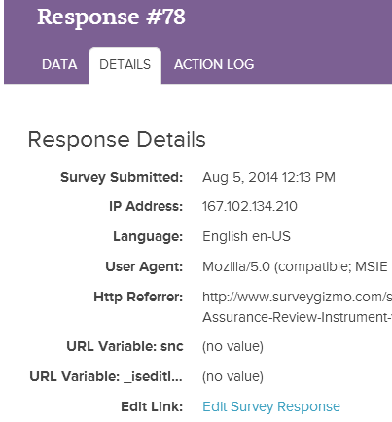
On-Line Efficiency:
Made Possible by WiFi
. . . and an edit survey response “safety net.”
Notes:
In summer 2013, DORS began to roll out “wireless” capability to every office across the state, and, in so doing, launched us well on our way toward using an on-line survey tool in the completion of unit reviews.
Every office has landlines for standard internet connectivity, so supervisory delegated authority reviews would not require wireless capability. However, this would not have been true in the performance of unit reviews, as all our case review staff assemble with their laptops in the conference room of the unit being reviewed, and each conference room has only one landline for the internet.
With WiFi, each of our team members, upon arrival, log into their laptops, and are immediately connected, to the internet, intranet, and the AWARE™ case management system.

Slide 10
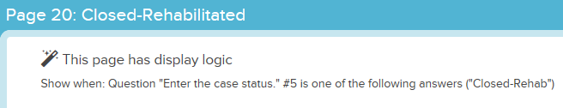
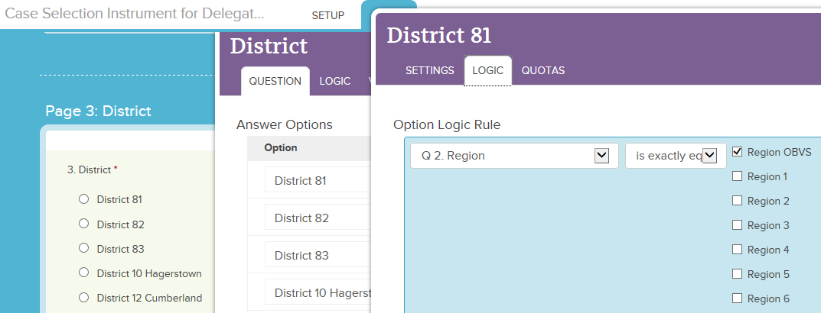

Building in efficiencies:
  “Show When” Logic
    Pages
    Options
  All questions required, when displayed.
Notes:
Everything the case reviewer is chosen by the survey designer.
For most question types, logic can be built in for when to display specific options. This is useful, because it allows all the responses to be catalogued in one reporting field. For instance, only the response options for “District” that are relevant to “Region OBVS” are shown when “Region OBVS” is selected.
Also, when a counselor with delegated authority leaves the agency or is promoted, logic can be used so that the counselor’s name will no longer appear as an answer option. This keeps the record review instrument “current,” without the administrator having to “disable” the response option entirely. This is significant, because response options that have been disabled will not appear in future reports.
Choose to require all questions, because “show when” logic allows for only questions to which we want responses to be shown.

Slide 11
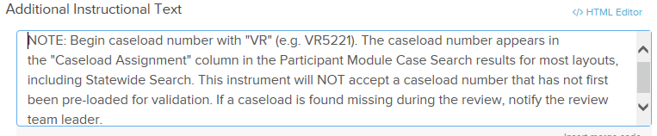
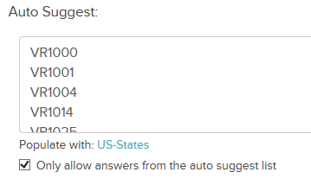
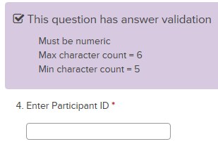
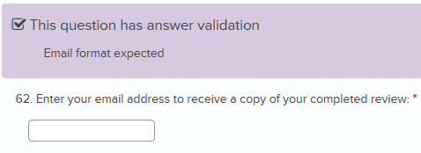
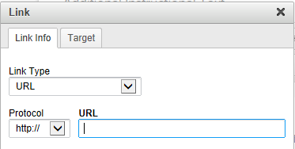
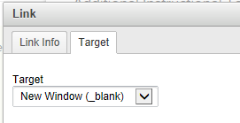
Building in efficiencies:
  Additional Instructional Text
  Validation
  Hyperlinks
Notes:
Additional Instructional Text:
Instead of a separate “case review manual” to provide instruction on how respondents should answer a question in different situations, we have found it most helpful to add that guidance immediately above the question itself in the record review instrument. Also, a hyperlink to relevant policy in the electronic policy manual can also be created. When doing so, be sure to select “New Window” in the Target tab, so that the policy will be displayed in a new window other than the window in which the record review is displayed. This will prevent the staff member from accidentally closing the record review instrument after they are finished reviewing the policy.
Validation:
Validation can save time and prevent user errors when “only allow answers from the auto-suggest list” is selected. When auto-suggest is used, staff only need to enter the first few letters before auto-suggest displays the caseload, Participant ID, or email address that they are typing. Participant ID validation is added to the Quality Assurance Unit Review instrument after the cases are randomly selected. Because Participant IDs are being created daily, we are not currently adding them to the Delegated Authority Review instrument.
Validation for e-mail addresses is used in all instruments, especially because we want to ensure that the respondent and/or their manager receives a copy of the completed record review automatically upon completion.

Slide 12
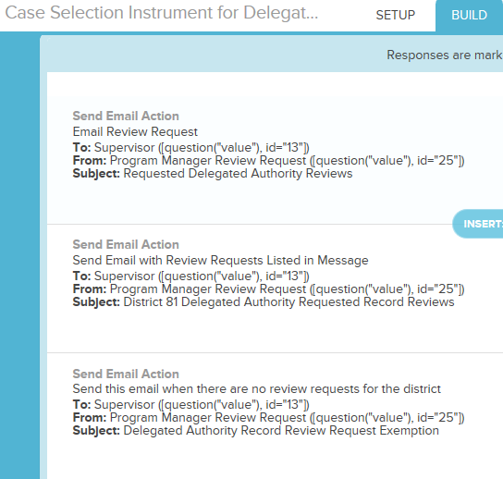
Building in efficiencies:
  “Thank-You” Page:
  Email Actions:
Notes:
The record review is considered “complete” by SurveyGizmo when the “Thank-You” page has been reached.
If reviewers have additional record reviews to complete, a link is available in the message for them to begin immediately.
Clicking the link opens a blank survey in a new window.
The case reviewer is asked to enter their email address so that a copy in PDF of the review can be sent to them automatically. In addition, a “Case Review” mailbox was set up, specifically to receive “carbon copies” of all case reviews completed, as well as all delegated authority review requests and completed delegated authority reviews.
Note: the PDF attachment sent via the email action is not easily accessible to JAWS, and we have a supervisor who is blind completing delegated authority reviews, who especially needs to know what cases she is being asked to review. With that in mind, SurveyGizmo support assisted me to create an email action with the review requests for her district imbedded in the body of the email itself, rather than as a PDF attachment. They also catalogued my request to have the option to set up email actions to send survey responses in Word documents rather than PDFs, as Word documents are much more easily accessible to JAWS than PDFs.

Slide 13
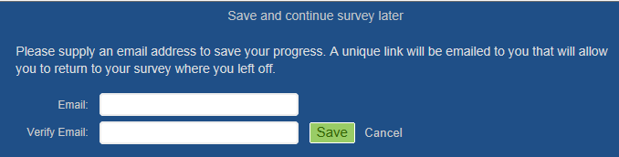
Using the Efficiencies:
During the initial review:
  “Back” and “Next” buttons
  Progress Bar
  “Save and Continue Later” feature
  Require comment when reviewer indicates “Partially Present” or “Not Present”
  Email completed review to reviewer
During consensus building:
  Export comparison report to Excel
  Copy n paste into Excel comparison template
  Make required edits in one review in Survey Gizmo
  “Delete” the second review for the case in Survey Gizmo
Notes:
We initially considered trying to build the record review instrument in “Sharepoint,” but nixed that idea when we found that SharePoint does not provide a “Back” button. When a reviewer finds a document stapled in the file in a place other than expected, after responding to a question that the document was not in the file, that reviewer needs the option to go “Back” and edit the response!
We have the option to display the progress bar at the bottom or top of the page or not at all. We’ve chosen to display it, because it appears to motivate our reviewers to finish the review on which they are working before lunch or the end of the day.
If a reviewer must go to lunch or leave before completing a review, the surveys are equipped with a “Save and Continue Later” feature that asks for an email address, and then saves the reviewer’s progress and sends a link to the partially completed survey to the email address provided. These surveys are retained as “Partially” complete in SurveyGizmo, and will remain so, until either the reviewer completes the review, or they are deleted by an administrator. Some reviewers who are nervous about losing their network connections may choose to use this feature just to save their progress, and then “Continue the Survey” immediately.
For consensus building, we

Slide 14
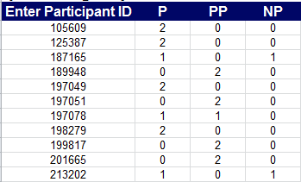
Why “Consensus Building”?
QA Unit Review Team response congruence prior to consensus building:
  June (pilot): 12 cases reviewed, 2,550 questions answered, 74.74% congruence
  July: 10 cases reviewed, 2,158 questions answered, 81.28% congruence
  August: 11 cases reviewed, 2,410 questions answered, 80.66% congruence
Notes:
To obtain these figures, the Participant ID Question-by-Question Comparison Report must be run prior to consensus building (before the reviews are edited or deleted).
For each Participant ID and response option, the number “2” means both reviewers agreed. Where there are two number 1’s, the reviewers need to build consensus.
We believe an 80% baseline for congruence is adequate, but hope with further refinement of the instruction available within the instrument itself, to see this number increase.

Slide 15
Reporting Efficiencies:
Immediate Feedback Provided to District Staff at end of 2nd day
  Run summary report for each district
  Exclude N/A options percentage calculations
  Export summary report to Excel for quick review
  Identify highlights
Summary Report Provided to Executive Staff within seven days
Follow-Up: Regional Director prepares a Quality Control Plan within 30 days
Notes:
Fundamental to the success of this case review process is the implementation of an agency-wide communication process that timely and accurately reports findings, recommendations and corrective actions taken. This process must ensure follow-up action is effective in addressing sub-standard quality and failure to meet compliance standards.
Mid-afternoon on the second day of the review, after all consensus building is complete, a summary report is run for each district reviewed, and the exported to Excel. The Summary Report “Statistics” can be designed to exclude answer options designated as “N/A” from the percentage calculations. Then, in Excel, it is quite simple to filter the columns for specific percentages. During the immediate review with the district staff, all questions to which “Present” was the response at least 90% of the time are highlighted as satisfactory, then those which were partially present or not present are also noted.
Within seven days of the completed review, the Office Director and Regional Director will receive a report communicating the findings. Regional Directors are responsible for developing a plan of correction and may also take other appropriate action to address compliance or quality issues that do not meet established standards (90% present or better). The plan of correction must be submitted to the program director within 30 days of the receipt of the formal case review report. Review findings will be shared with executive staff on a quarterly basis.

Slide 16
Next Steps :
September 2014:
  Train all 8 core review team members on how to run reports for consensus building during the unit review.
  Redesign the Delegated Authority Review Instrument
  Provide an end-of-year report to Executive Staff identifying any trends noticed during unit reviews .

Slide 17

Additional Resources:
Need help selecting an on-line survey tool to use?
Check out:
http://www.relevantinsights.com/free-online-survey-tools
Notes:
DORS began using SurveyGizmo when our staff specialist for electronic accessibility found their support team will and able to work with her on making their surveys accessible for persons with blindness. Since we already had an account with SurveyGizmo, we built our first delegated authority review instrument using SurveyGizmo, and have stuck with them ever since. In my experience, their support team members have always proven responsive, competent, and enthusiastic.
If your agency is already using a different on-line survey tool, then you should still be able to use many of the same or similar efficiencies shown here.
If your agency is not already using an on-line survey tool, then this article available on-line should be helpful.

Slide 18

Contact Information:
John Stem
Staff Specialist, Program Evaluation
Division of Rehabilitation Services
2301 Argonne Drive
Baltimore, MD 21218
410-554-9536
jstem@dors.state.md.us
http://www.linkedin.com/in/jstem

