Slide 1
Evaluating the VR Agency’s Human Resource Functions: Are you getting the most from your workforce?
7th Annual Summit on Performance Management
Dana Jefferson, Ph.D., SPHR
Leslie Scott

Slide 2
Nothing can be said to be certain except death and taxes. Benjamin Franklin

Slide 3
Benjamin Franklin said there were only two things certain in life: death and taxes. But I’d like to add a third certainty: trash. And while some in this room might want to discuss reducing taxes, I want to talk about reducing trash. Ruth Ann Minner

Slide 4
What keeps VR Directors up at night?

Slide 5
Session Overview
Looking at the big picture: HR Statistics and Measurement
Other Helpful Tips and Tools

Slide 6
2006 HR Metrics Toolkit: National Association of State Personnel Executives (NASPE)

Slide 7
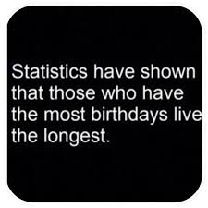
Categories of Strategic HR Measures
Recruitment and Selection
Compensation & Benefits
Training & Development
Retention
Employee Relations
Human Resources Costs

Slide 8
Recruitment and Selection
Quality of Hire
Quality of Job Fit
Job Offers Accepted Rate
Quality of Applicant Pool

Slide 9
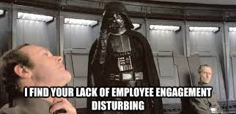
Retention
Voluntary Turnover of Key Performers in Key Jobs
Diversity Turnover
Employee Engagement

Slide 10
Compensation and Benefits
Salary Competitiveness of Market Rate
Percentage Difference in Pay Increases Between Top Performance Rated Employees
Market Competitiveness of Actual Base Salaries
Market Competitiveness of Pay Structure
Ratio of Total Compensation Cost to Total Budget

Slide 11
Employee Relations
Turnover of Top-Rated Performers
Impact on Diversity of Employment Actions
Percentage of Administrative Actions Overturned by Reviewing Bodies

Slide 12
Training and Development
Satisfaction with Learning Opportunities
Training Impact on Performance
Training Costs
Training Hours per Employee

Slide 13
Other Helpful Tips and Tools
Workforce initiatives as part of RTAC grant

Slide 14
drdanajefferson@earthlink.net
Lscott@csg.org

