Slide 1
VR-ROI Further Discussion: Return on Investment of a Collaborative Transition Program
Dr. Kirsten Rowe, Virginia Department for Aging and Rehabilitative Services
Dr. Robert M. Schmidt, University of Richmond
Dr. Steven Stern, University of Virginia
7th Annual Summit on Performance Management in Vocational Rehabilitation
Louisville, KY: September 8, 2014

Slide 2
Presentation Overview
Why ROI?
Overview of the VR-ROI Project
Overview of Post-Secondary Rehabilitation/ Transition (PERT) Program
Review of results from earlier PERT study
Initial Findings from our new “Structural Equation” Model using DRS Applicants in 2000
Value to PERT Staff and Clients

Slide 3
Why ROI?
DARS involvement in Return on Investment
To develop a more credible assessment of the value of the VR program
To demonstrate the importance of using longitudinal data measures particularly with transition youth
VR-ROI Project funded by NIDRR

Slide 4
Major PERT Components
10-day residential program with comprehensive career assessment
hands-on work samples
independent living skills assessment
integrated report tailored to individual school systems
Community-based implementation of assessment findings
local cross-agency implementation teams
regular team review of student progress

Slide 5
Evaluating PERT
Our previous PERT analysis
Current VR-ROI project

Slide 6
A Comparison Group Approach to Assessing PERT Labor Market Outcomes
Cohort: Applicants for DRS Services in SFY 1988

Slide 7
Quasi-Experimental Outcome Evaluation Framework
Assessing PERT impacts requires “compared to whom?”
Alternatives for “real-world” settings use matched comparison groups
Natural experiment when program is only available in selected areas or for selected populations

Slide 8
The Early PERT Study Sample
Sample Frame included SFY 1988 PERT & other VR participants <age 18 in a “natural experiment”
PERT participants matched on demographic and disability characteristics (only ID & LD) with DRS “business as usual” comparison group in same geographic planning district
N=91 in PERT “treatment group”, N=142 in non-PERT “business as usual comparison group”
Differed in terms of race and disability severity

Slide 9
Long-Term Outcome Data
State Unemployment Insurance records have quarterly data for people in “covered employment”
Study used quarterly earnings from the Virginia Employment Commission from FY 1985-2000
Includes 3 years pre-application, year of application (FY 1988), and 12 years post-application
“Hit rate” of about 80% having at least one quarter of covered employment

Slide 10
Notes:
Chart 1, titled Earnings During the Year, if any shows average annual earnings in “real” 2002 dollars for the PERT participants versus the non-PERT comparison group receiving DRS “business as usual” services. Earnings are provided from the period three years prior to application for DRS/PERT services through 12 years post-application. Annual earnings for the comparison group dipped from $8,000 down to about $5,000 through the application period and then slowly increase to about $10,000 ten years after application. Meanwhile, earnings steadily increase for the PERT participants, starting at about $2,000 in the three years prior to application and then surpassing those of the non-participants (at $10,000) in the fifth post-application year and then continuing to rise, approaching $15,000 by the tenth post-application year.

Slide 11
Notes:
Chart 2 is titled Estimated Earnings Impacts of PERT and provides these in real inflation-adjusted 2002 dollars starting from the point of application through ten years post-application. Earnings impacts are negative for PERT participants for post-application Years 1-3 viz-a-viz their comparison group of DRS business-as-usual participants. These earnings impacts, controlling for socioeconomic, demographic, and economic environment attributes, then increase over the next ten years eventually exceeding $5,500 annually.

Slide 12
Study Limitations
Uses comparison group that differs observably and “unobservably” from PERT treatment group
Looks only at aggregate PERT impacts and cannot isolate other potential impacts
Says nothing about impacts of subsequent VR service provision

Slide 13
A Structural-Equations Approach to Assessing PERT Labor Market Outcomes
Cohort: 3,073 First-time DRS Applicants aged 15-24 (out of all 10,323) in SFY 2000

Slide 14
The PERT 2000 Study
Focus now is on transitioning youth (ages 15-25) with ID, MI, and/or LD
DRS applicants in SFY 2000
Labor Market Impacts of PERT directly as well as through interaction with schooling and VR services

Slide 15
Our VR-ROI Innovations (1)
Linking readily available administrative data (AWARE, WWRC, VEC, VDOE, BEA)
Change perspective from closure to applicant cohorts
Use longitudinal earnings for every DRS applicant to obtain pre and post-VR earnings paths

Slide 16
Our VR-ROI Innovations (2)
Examine longitudinal service provision (anchor case, subsequent, and prior)
Account for all services (purchased, similar benefits, in-house)
Crack the “black box” of VR service provision – “DTERMO” service categories
Develop a model adaptable to estimating VR impacts by program type or impairment grouping
Use exogenous variation to explain participation in PERT and participation in DARS services

Slide 17
Potential Ways for PERT to Affect Labor Market Outcomes
PERT May Affect the Efficiency of DRS Services on Employment Outcomes
PERT May Affect the Efficiency of Remaining School Time on Employment Outcomes
PERT Services Alone May Directly Affect Employment Outcomes
Notes:
There are three potential ways for PERT to affect labor market outcomes: 1) PERT may directly affect employment outcomes.; 2) PERT may affect the efficiency of the remaining time in school as it impacts on employment outcomes; and 3) PERT may also affect the efficiency of subsequent VR services which then impact on employment outcomes.

Slide 18
Proportion Receiving Purchased VR Services, by Type
 | Those Receiving PERT Services | Those Not Receiving PERT Services
# Observations | 199 | 1774
Diagnosis & Evaluation | 0.427 | 0.624
Training | 0.432 | 0.400
Education | 0.096 | 0.167
Restoration | 0.085 | 0.312
Maintenance | 0.352 | 0.277
Other Service | 0.477 | 0.351
Note: Proportions are conditional on receiving some DRS purchased service.
Notes:
Table: Proportion receiving VR Services by Type
Among the 394 PERT recipients, just over half, 199, receive DRS purchased services. Among the non-PERT recipients, 1774 receive DRS services, and 905 do not. Clearly, PERT recipients are less likely to receive DRS purchased services. This patterns also holds for particular services, such that non-PERT recipients are much more likely to have purchased services on diagnosis & evaluation, education, and restoration.

Slide 19
PERT Labor Market Impacts
Variable | Impact on | Impact | Significance
PERT Participation | Employment Earnings | 30.6% 31.3% | 5% 5%
PERT*Remaining Quarters of School | Employment Earnings | 24.2% 16.6% | 5% 5%
PERT*VR Services (short run/long run) | Employment Earnings | 27.1/43.8% 13.2/19.4% | 5% 5%
Notes:
This table provides a summary of the three separate PERT labor market impacts. The direct impact of PERT participation is positive and significant on both employment probability (12% increase) and earnings (29% increase) versus those not-PERT DRS participants. Meanwhile, the indirect effects of PERT interacting with schooling and VR services are also both positive and significant.

Slide 20
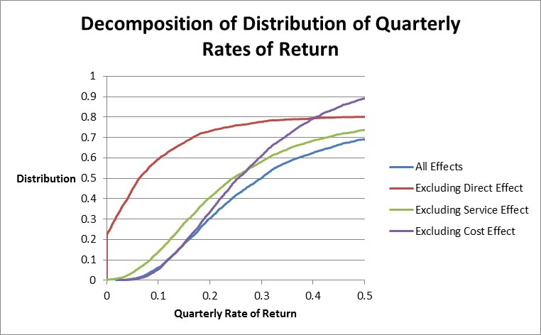
Distribution of Quarterly ROR

Slide 21
What does this ROR imply?
On an “investment” of $3,500 in PERT:
Present value of increased earnings converts to roughly $1,050 per quarter
Or, an annual increase of $4,200 over the non-PERT receiving DRS consumers
Over a five-year (20-quarter) horizon this amounts to some $21,000 in increased earnings due to PERT participation

Slide 22
ROI Value to PERT
Value to PERT Staff
Value to PERT Participants
Value to PERT Partners

Slide 23
Value to PERT Staff
PERT Counselors tell students, families, local schools that after 10 years, the typical PERT student is making $4,200 more per year than their non-PERT peers
PERT Counselors tell 10th-graders that they can be “especially successful” because there is still time during high school to implement the recommendations from their PERT assessment
PERT Counselors receive “validation that my time and effort have been well spent.”

Slide 24
Value for Participants
Reinforces PERT goals for participants:
Improved understanding of disability and how to achieve goals
Strengthened independent living applications at home and in community
Foster more interest in school and reduce early drop-out rate
Increase long term earning potential

Slide 25
Value to PERT Partners
PERT goals for the school systems:
Collaborative local-level transition planning
Improved transition planning – early planning better than later
Provides age appropriate transition services
Strengthens collaborative efforts with VR

Slide 26
So…..
How does PERT use ROR information for marketing?

Slide 27
Facts for Students and Parents About PERT:
On average, ignoring interaction effects, going to PERT increases your chances of finding and keeping a job by 31%, and, if you have a job, it increases how much money you make by 31%.
On top of that, if you are receiving services from DARS, it makes those services more effective in the long run by 44% in terms of you getting a job and 19% in terms of money you make.
Even on top of that, if you stay in school one more year after PERT, on average, your chances of getting and keeping a job increase by 96%, and, if you get a job, the money you make increases by 68%.
As an example, consider someone who has not participating in PERT who earns $200/week. By participating in PERT, the person’s earnings increase from $200/week to $200*1.31=$262/week; staying in school increases it yet again to $262*1.68=$440/week; and using DARS services increases it even more. Some people will do better, and some will do worse. But, on average the effect is to more than double earnings in the long run.

Slide 28
PERT Impact on Finding a Job and Income
Increases chances of finding and keeping a job by 31%
Combined with one more year of education the chance of getting and keeping a job increases by 96%
After you find a job, participating in PERT will on average double the amount of a student’s earnings in the long run

